Slide 1
Lesson Plan
This could be used as a reference tool for a teacher or could be used as a powerpoint presentation in the classroom

Slide 2
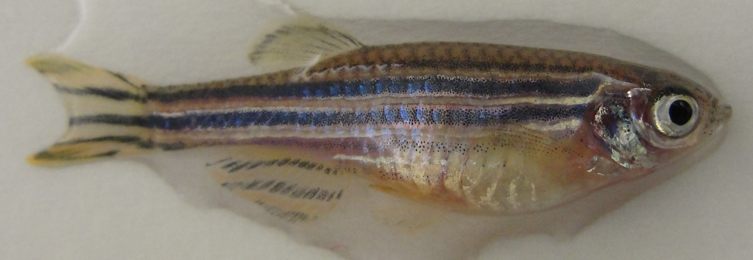
Genetics of Glofish

Slide 3
There are many different variations in what zebrafish look like. In many organisms, including zebrafish, variations arise through mutations. In the genetically engineered zebrafish called Glofish, the variations come from people altering the fish’s genome. Mutation - an alteration of genetic material (DNA). In some cases, this produces a new variation.

Slide 4
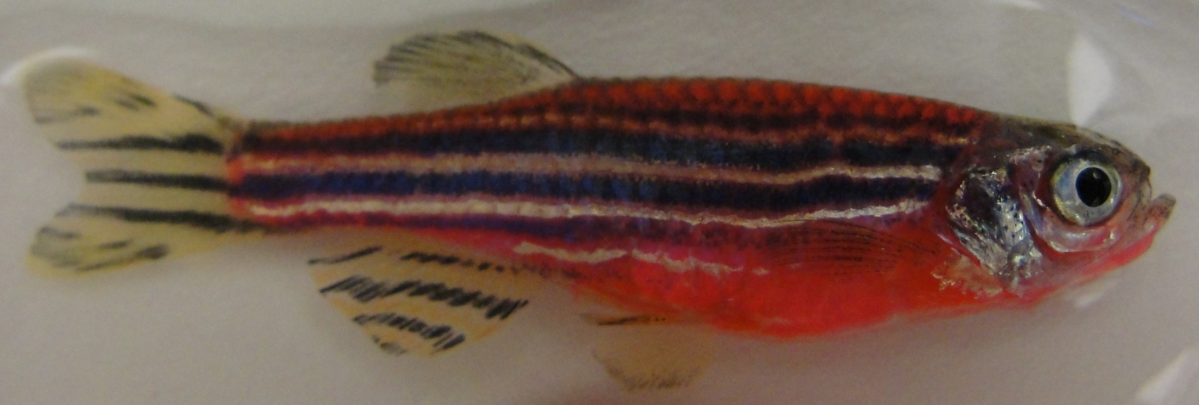
Examples of different colors from human alteration
The following color phenotypes were created by humans inserting jellyfish DNA into glofish.

Slide 5
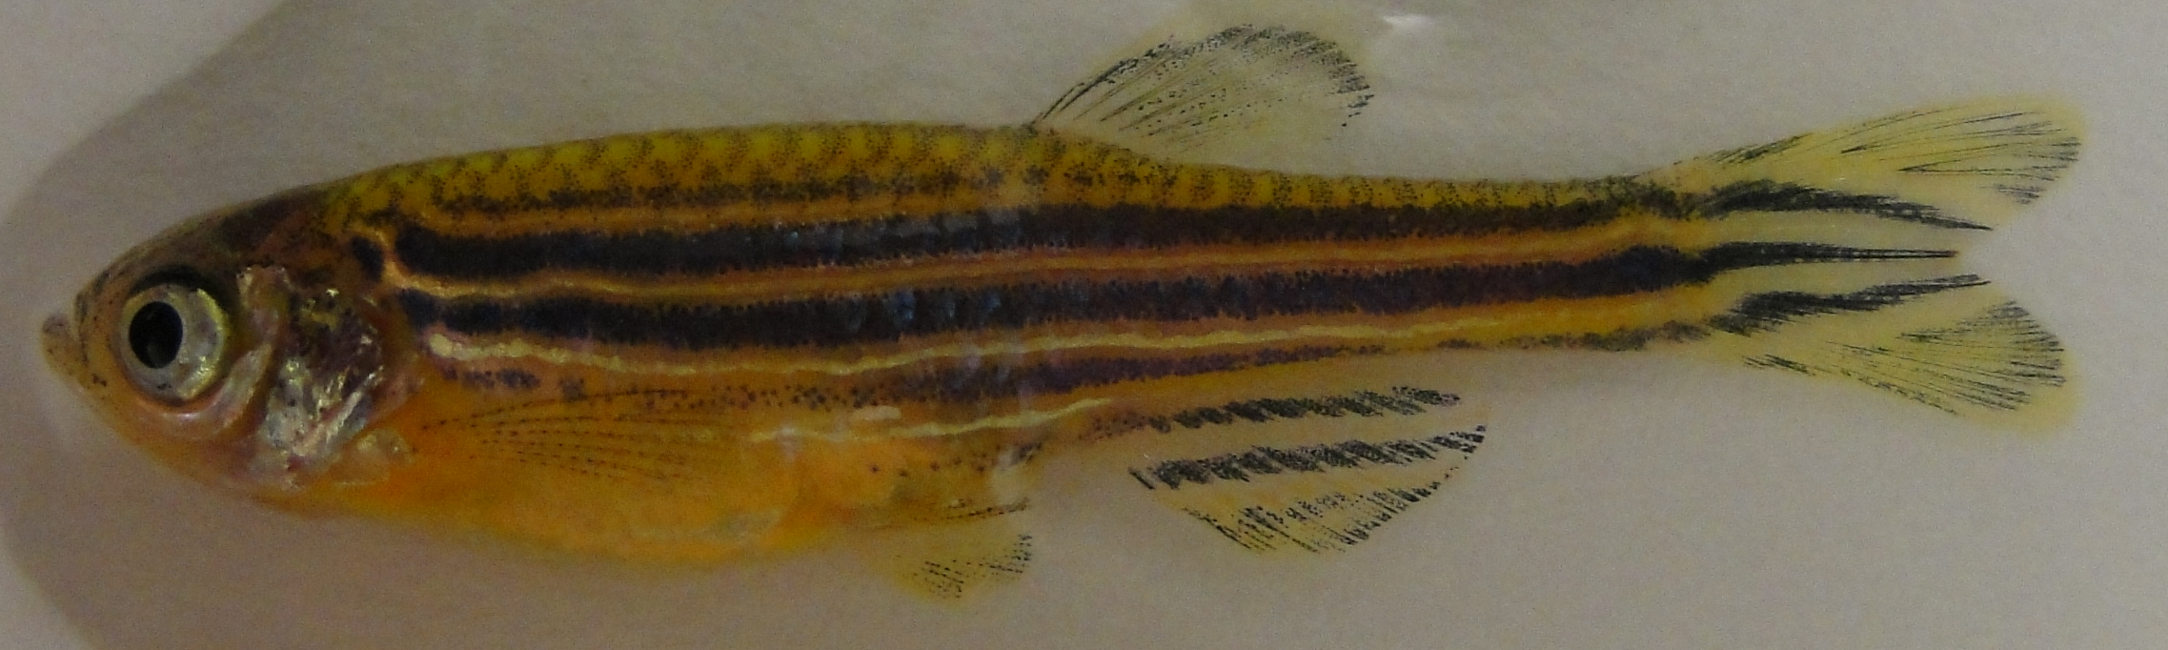
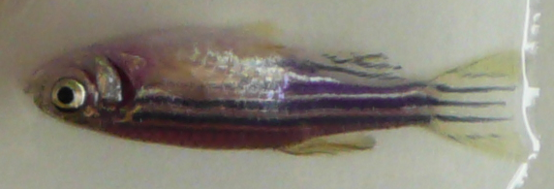

Slide 6
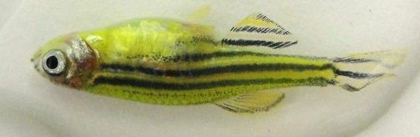
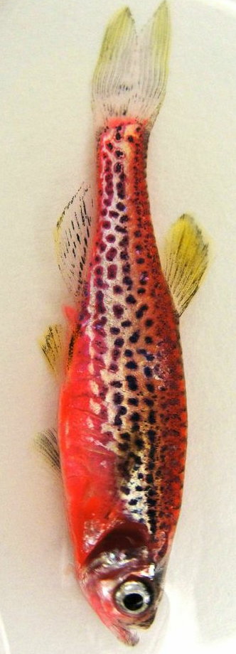
Examples of naturally occurring phenotypes caused by mutations
Striped vs. Spotted

Slide 7
Dominant/Recessive
Dominant allele (A)- an allele that masks the presence of a recessive allele in the phenotype. Dominant alleles for a trait are usually expressed if an individual is homozygous dominant or heterozygous. These are represented by an uppercase letter.
Recessive allele (a) - an allele that is masked in the phenotype by the presence of a dominant allele. Recessive alleles are expressed in the phenotype only when the genotype is homozygous recessive (aa). Recessive alleles are represented by a lowercase letter.

Slide 8
Genotype – the genes in the organisms DNA.
Phenotype – the physical appearance of the fish in the pictures. This is determined by the genotype.
Heterozygous – The two alleles of the same gene are different
Homozygous – The two alleles of the same gene are alike.
Hemizygous – There is only one allele of a gene. For example, this can happen in humans for genes on the Y chromosome. This can happen in genetically engineered organisms that have the inserted gene only on one of their chromosomes (like some GloFish).

Slide 9
Homozygous allele
There are two variations of the homozygous trait.
Homozygous dominant – two dominant alleles
Homozygous recessive – two recessive alleles

Slide 10
Codominance
Codominance - the situation in which two different alleles for a trait are expressed unblended in the phenotype of heterozygous individuals. Neither allele is dominant or recessive, so that both appear in the phenotype or influence it.
For instance, the progeny of a plant with red flowers and a plant with white flowers might have flowers that have both red and white sections.

Slide 11
Incomplete Dominance
Incomplete dominance - the situation in which two different alleles for a trait are expressed as a blended phenotype in the phenotype of heterozygous individuals.
For instance, the progeny of a plant with yellow flowers and one with red flowers might have orange flowers.

Slide 12
Punnett Squares
To figure out the potential genotypes that can result from a cross between two individuals, we use Punnett squares.
For instance, organisms with a genotype of Yy will produce gametes of Y and y. When the gametes combine with the gametes of the other parent to form zygotes, there are multiple combinations of genotypes possible in the progeny.

Slide 13
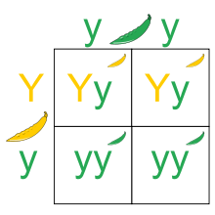
In this example, the parent genotypes were Yy, and yy. We put the gametes produced by the parents outside of the box and the gametes produced inside.
Notes:
If they had previously learned mendalean genetics, this would be a good way to relate glofish genetics to mendalean pea genetics.
At this point I think the middle school worksheet can be done.
http://upload.wikimedia.org/wikipedia/commons/thumb/2/22/Punnett_Square.svg/220px-Punnett_Square.svg.png

Slide 14
Principle of Segregation
Principle of segregation - Gregor Mendel's first principle of genetic inheritance. It states that, for any particular trait, the pair of genes of each parent separate (during the formation of sex cells) and only one gene from each parent passes on to an offspring. In other words, genes occur in pairs (because chromosomes occur in pairs). During gamete production, the members of each gene pair separate, so that each gamete contains one member of each pair. During fertilization, the full number of chromosomes is restored, and members of gene pairs are reunited.

Slide 15
Principle of Independent Assortment
Principle of independent assortment - Gregor Mendel's second principle of genetic inheritance. It states that different pairs of genes are passed to offspring independently so that new combinations of genes, present in neither parent, are possible.
In other words, the distribution of one pair of alleles does not influence the distribution of another pair (as long as they are on different chromosomes). The genes controlling different traits are inherited independently of one another.

Slide 16
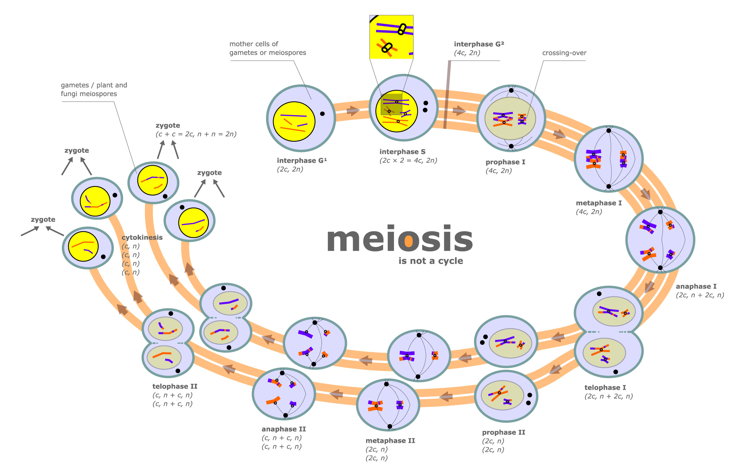
Notes:
http://legacy.owensboro.kctcs.edu/gcaplan/anat2/notes/Meiosis_diagram_jpg.jpg

